Slide 1

May 21, 2026
HSC COUNCIL
Mike Richards, MD, MPA
Executive Vice President of UNM Health Sciences & Chief Executive Officer of the UNM Health System

Slide 2
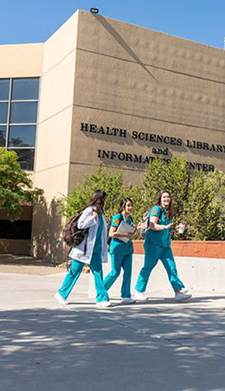

2026 UNM HSC Legislative Update
Legislative Appropriations
Health Care Workforce Expansion, Graduate Medical Education, Access
Project Title | FY27 Request
Student Support | $4,200,000
Faculty Support | $24,000,000
Graduate Medical Education | $28,000,000
UNM School of Medicine new facility - total | $576,000,000
Behavioral Health Technical Assistance Center | $6,800,000
Research and Innovation
Project Title | FY27 Request
Bioscience-related activities & develop AI | $5,000,000
Actuarial study on health care | $3,000,000
Multimodal brain imaging scanners with School of Engineering and College of Arts & Sciences) | $5,000,000
Northern NM Clinic | $15,000,000
Notes:
Continued focus on workforce expansion, access to care, and research growth
$24M for rural GME programs and rotations; $2M for resident/fellow compensation
$21.5M for clinical faculty compensation to support recruitment and retention
Investments in research and innovation, including biosciences, AI, and advanced imaging
$6.8M to establish a Behavioral Health Technical Assistance Center supporting statewide reform
Operational funding for the College of Population Health to sustain programs statewide and support accreditation
$15M for building a comprehensive reproductive health clinic in Northern NM

Slide 3

School of Medicine
New Facility Project
OVERVIEW
350,000 SF facility - research growth, and future flexibility
Supports 200 med students per class
Enables 70+ research faculty in modern lab space
Includes 2 active-learning classes and
team-based simulation space
Features collaboration areas and study space for 400+ learners
10-15% shell space for future growth

Slide 4


How is the full project being funded?
Through coordinated state investment and university matching funds, this project supports expanding medical education and preparing the next generation of healthcare workers for New Mexico
State Legislative Funding
$ 280M
$ 150M
$ 116M
$ 30M
2026 SB240 (SSTB)
2026 HB2 / HB8 (HED Fund)
2026 HB248 (GO BOND)
2025 HB450 (GF)
UNM Institutional Investment
$ 60M Institutional Funds
$636M Total Project Funding

Slide 5
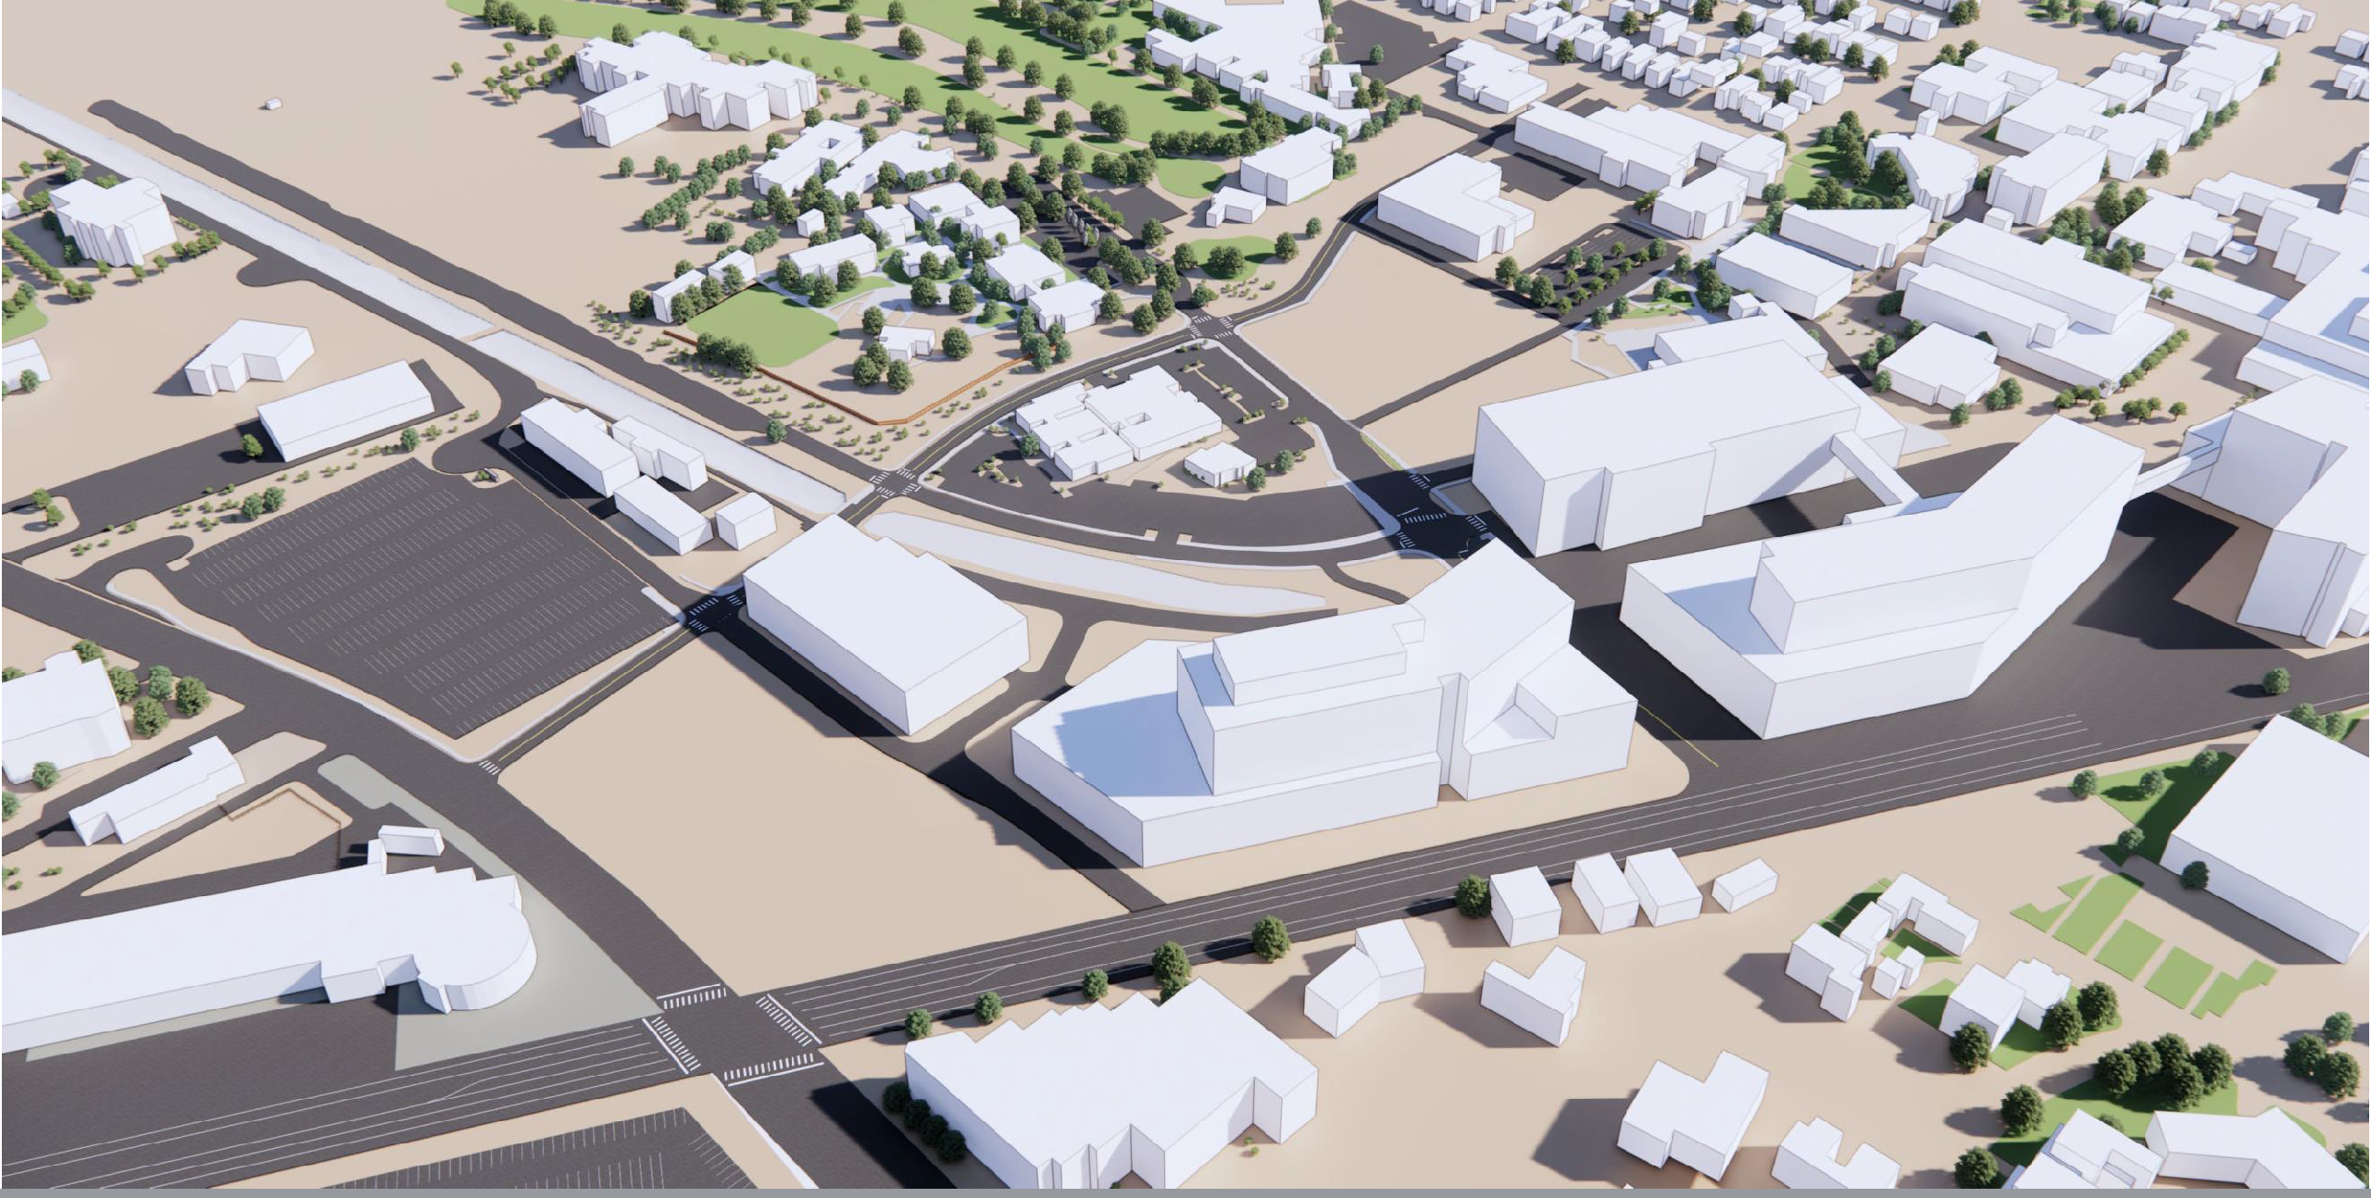

DOMINICI
CENTER
NURSING
BRF, ARF,
FITZH HALL
INNOVATION DISCOVERY TRAINING
DENTAL
CRF
PARKING
STRUCTURE
UNM
HOSPITAL
HOSPITAL TOWER
FUTURE
GARAGE
FUTURE MOB / CRITICAL CARE TOWER
School of Medicine
Future
Hotel
NORTH

Slide 6

Progress & Engagement to Date
HSCC & BOR partial approval requested
Project Presented
to Full Board of Regents as capital funding priority for FY26–FY27 submission to the Higher Education Department (HED).
Schematic Design Update presented to the Campus Design Review Committee (CDRC)
APRIL
2025
MARCH 2026
OCTOBER 2024
AUGUST
2025
Planning & Programming commenced to assess establish the appropriate scale and scope of the School of Medicine expansion.
Project Design Commenced
Project Presented At 2025 HED Summer Hearings as capital funding priority for
FY26–FY27

Slide 7
Upcoming Milestones
Mobilization for early site work & procurement of long-lead items
Full project approval requested at
December BOR/HSCCC
January HED Capital Outlay Committee
February State Board of Finance
Construction Completion
JUNE 2026
DECEMBER 2026
JANUARY 2030
NOVEMBER 2026
MARCH 2027
FALL
2030
Design Of Facility Nearing
Completion
Design development complete; construction documents nearing 90% completion
Full construction Mobilization commences
Project complete building occupancy begins for incoming Fall Class of 2030
Guiding The Project From Design Into Construction

Slide 8
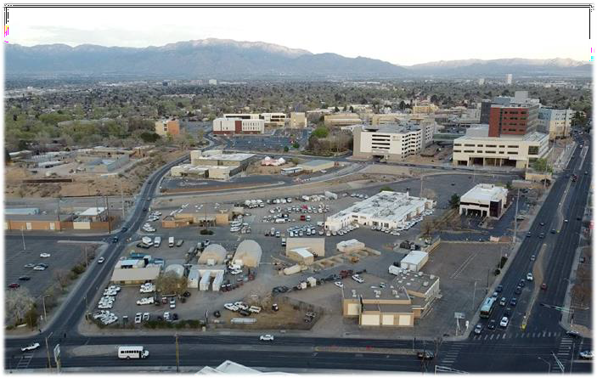
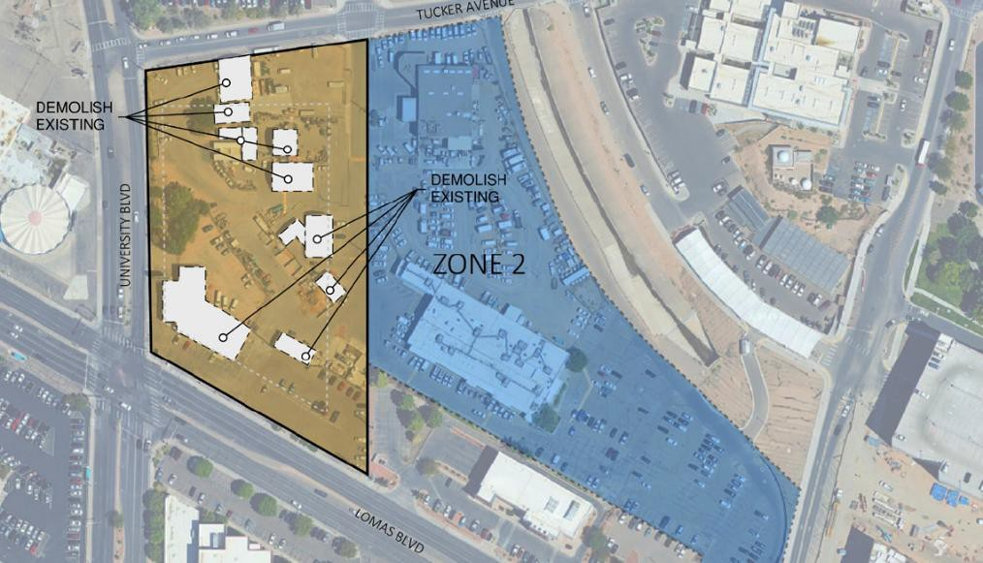

Site Mobilization
UNIVERSITY BLVD NE
SOM New Facility Site
1717 Lomas BLVD NE
Albuquerque, New Mexico

Slide 9
Early Work Phase
FI NA N C I A LS
$150,000,000
Early Work Investment
Early Site Work Includes:
Program Relocation, Enabling, and Design Progress Relocation activities and continued design development supporting construction readiness.
Site Preparation
Demolition, grading, and supporting utility infrastructure
Deep Foundations
Installation of deep foundation and below-grade structural systems
Primary Structural Frame
Early procurement, fabrication, and installation of the structural
system.
Long-Lead Equipment Procurement
Chillers, electrical switchgear, and major mechanical systems
C O ST B R EA K D OW N
$ 40,000,000 | Deep Foundations
$ 30,000,000 | Design & Enabling Activities
$ 30,000,000 | Structural Frame
$ 30,000,000 | Demo, Utilities, and Grading
$ 20,000,000 | Long-Lead Equipment Procurement
$ 150,000,000
Project Costs for this Phase

Slide 10
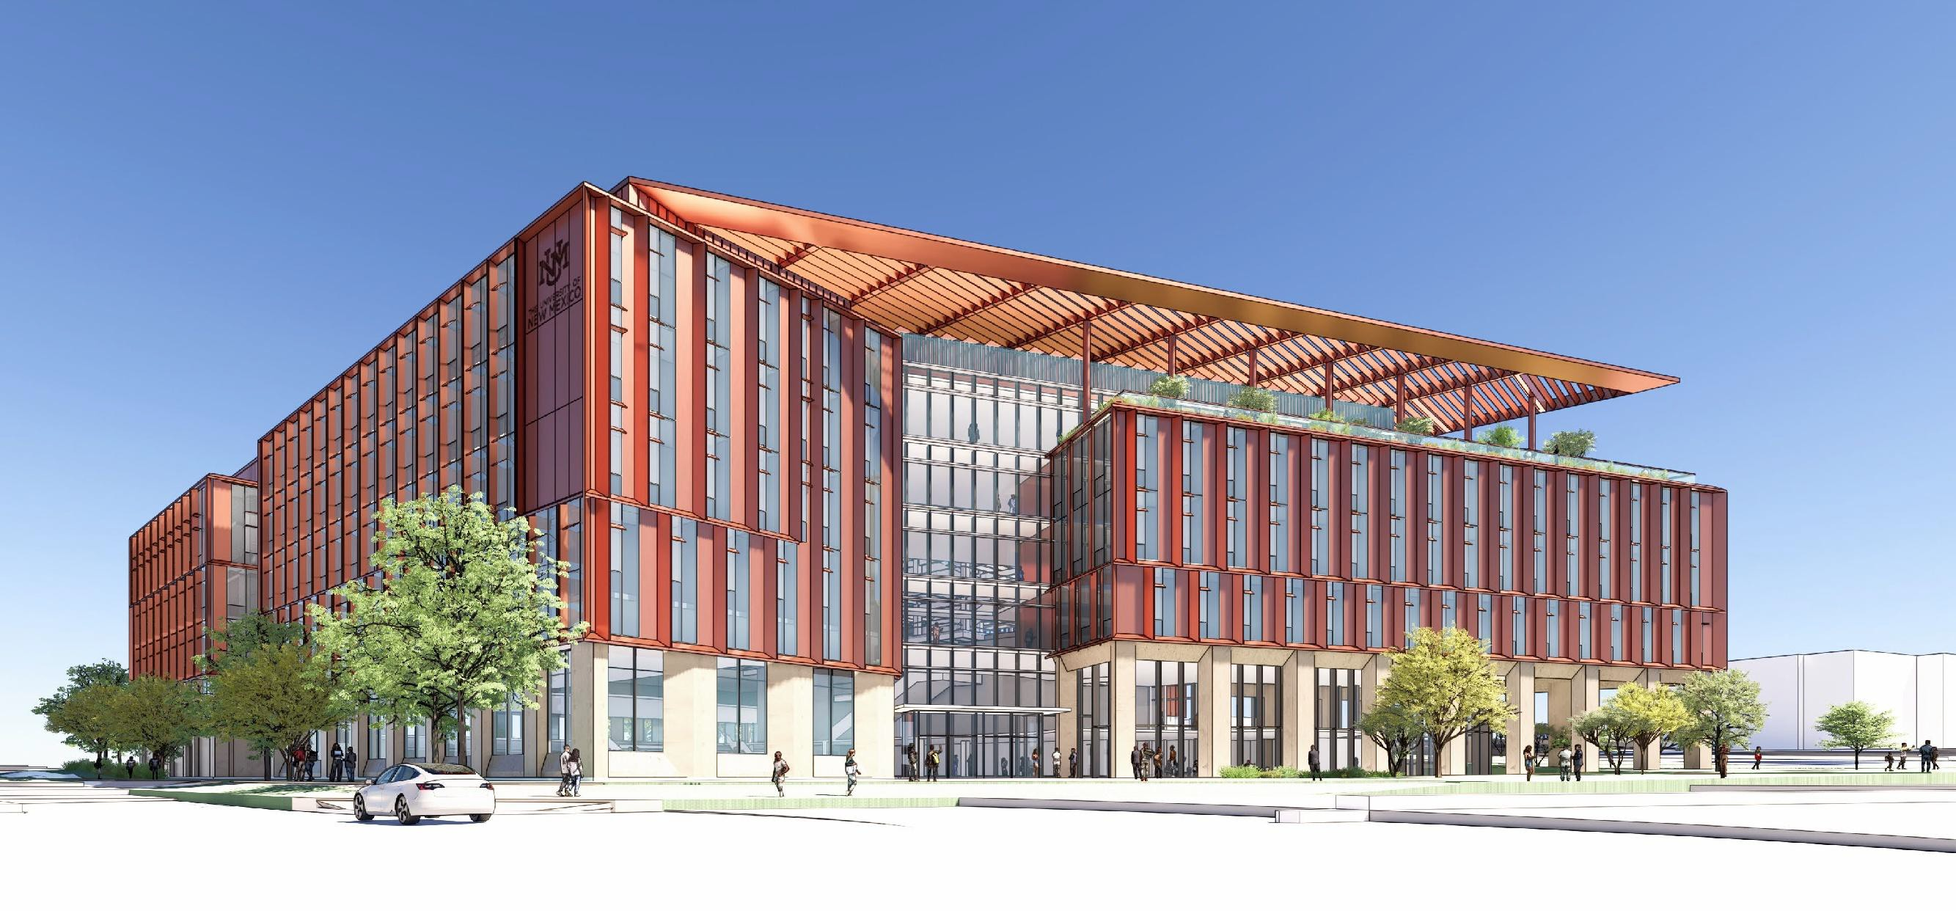
Early Rendering
View from Lomas Blvd Looking Northeast

Slide 11
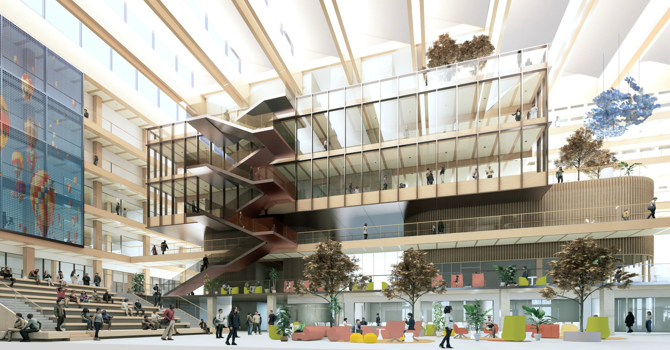
Early Rendering
Interior Atrium (Looking East)

Slide 12
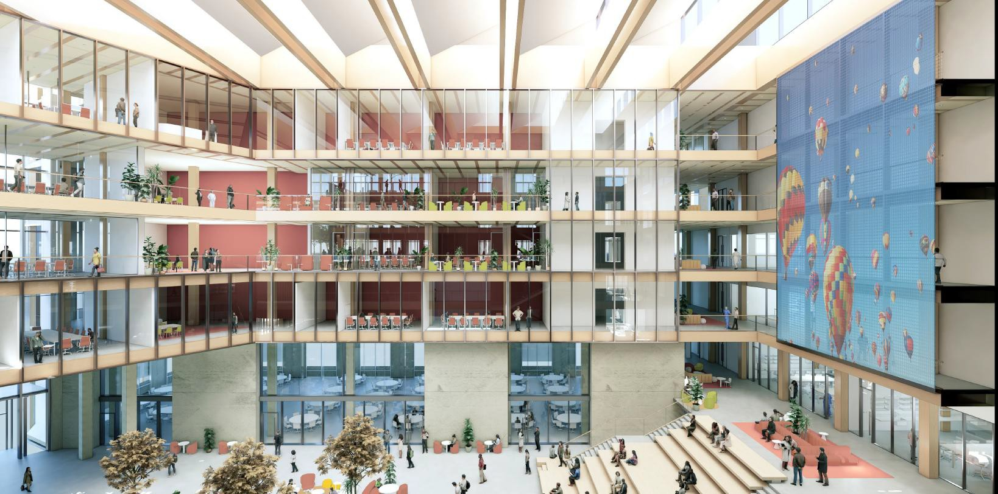
Early Rendering
Interior Atrium (Looking West)

Slide 13
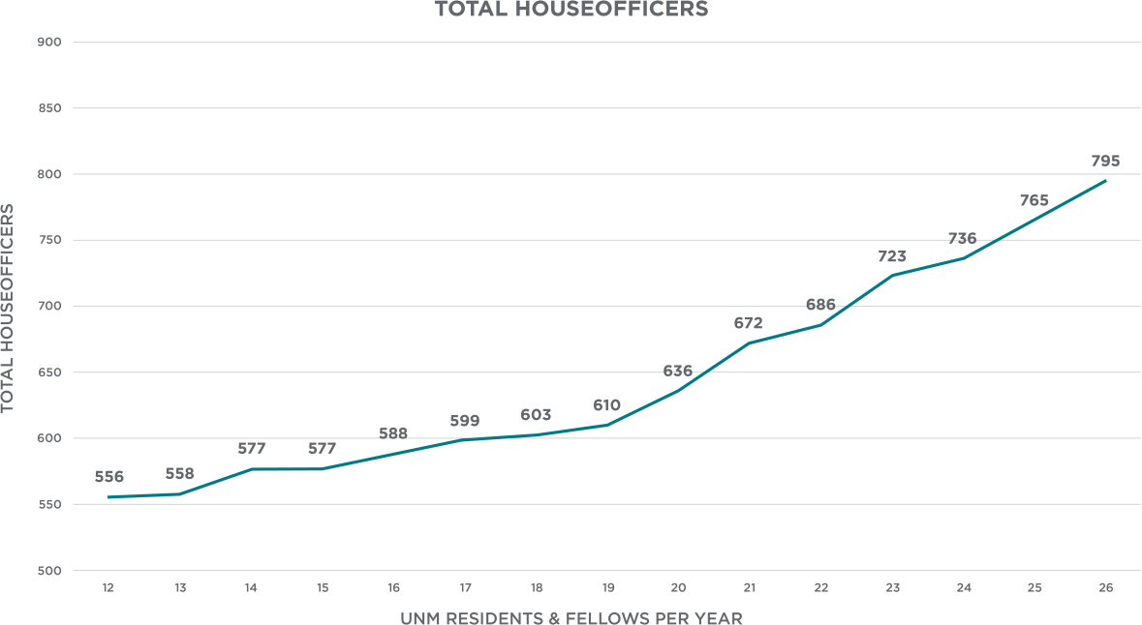
Graduate Medical Education
STUDENT & RESIDENT RETENTION
Medical Students
New Mexico – 38.5% National Median – 39.0%
GME
New Mexico – 40.3% National Median – 45.6%
Medical School and GME New Mexico – 68.2% National Median – 68.9%
24% increase in GME Positions
17 New Programs
12,000 Applications for 174 first Year Positions
Notes:
Workforce Retention by Program:
College of Nursing
~85% of graduates remain in New Mexico after graduation
College of Pharmacy
~81% of practicing pharmacists in New Mexico are UNM-trained
College of Population Health
~75% of graduates remain in New Mexico after graduation
School of Medicine – Health Professions Programs (Allied Health)
(Dental Hygiene, EMS, Medical Laboratory Sciences, Occupational Therapy, Physical Therapy, Physician Assistant, Radiologic Sciences)
~88–92% of graduates remain in New Mexico after graduation

Slide 14
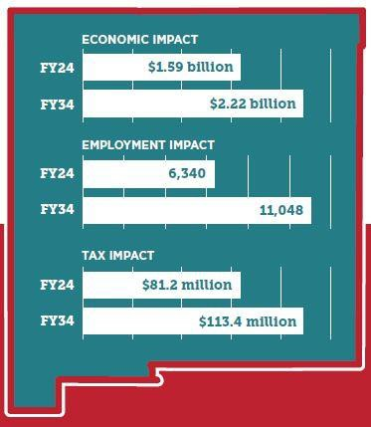
Economic Impact
Of UNM SOM Expansion
$290M - direct economic impact
$341M - indirect and induced
economic impact
565 – direct new jobs
4,143 – indirect and induced jobs
$32.2M in new state and local tax revenue
  $2.54 in state and local tax revenue for every $1 of additional state
funding
  $49.78 in statewide economic impact for every $1 received of state
funding

Slide 15
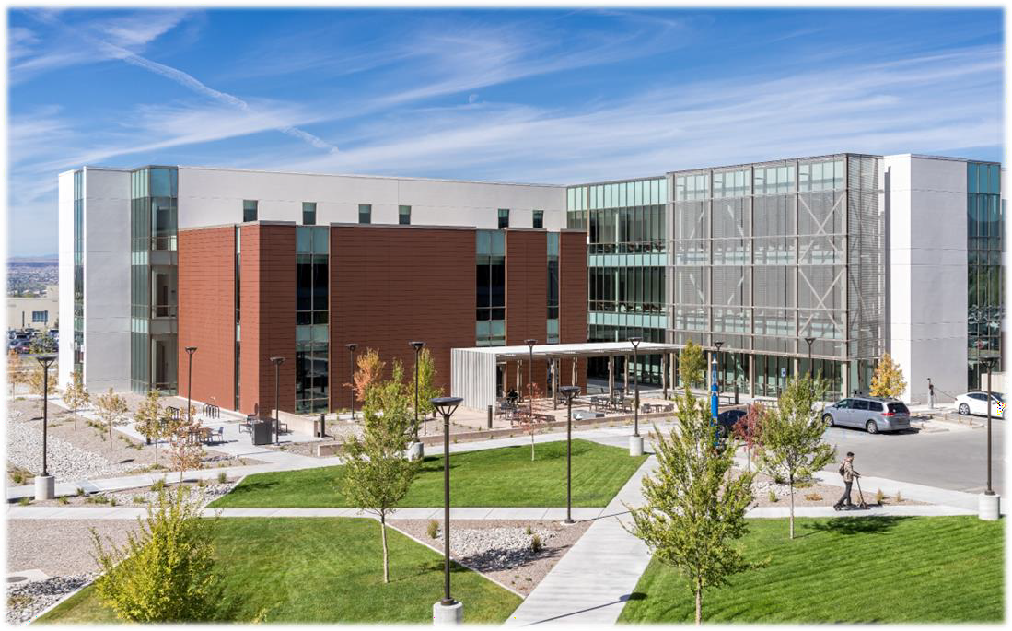
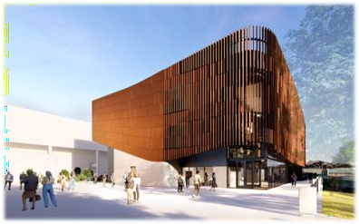
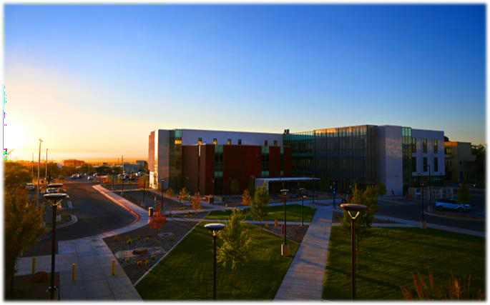
UNM HSC Colleges
Nursing
Pharmacy
Population Health
ENROLLMENT FALL ‘24-’25
32.6% growth
1,274 students
ENROLLMENT FALL ‘24-’25
3.3% growth
212 students
ENROLLMENT FALL ‘24-’25
20.3% growth (majors only)
127 students
Enrollment Increase 15.6%
Graduation Increase 16.3%
15

Slide 16
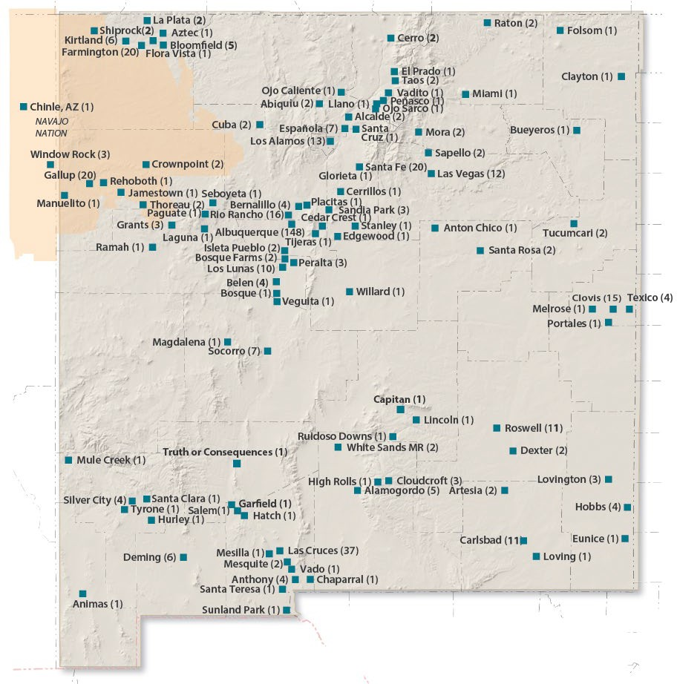


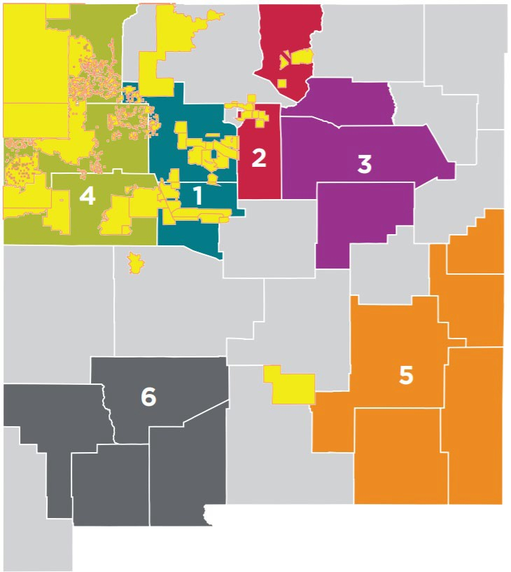
Healthcare Pathways
Admitted BA/MD Students 2006-2023
Communities to Careers and BA/MD Program
Growing Our Own Diverse Health Care Workforce
Facts and Figures
 | 12 Programs | 45 Locations | 19 Counties a Tribal Nati | 6 ^{nd} Regional ^{ons} Hubs | 700K+ K-20+ Students/Year | 3300+ 50% Participants First Generation Students |  | 72% Rural | 74% Underrepresented in Health Care
 | 81 |  |  | 65% | 23 | 62% | 67%
 | Practicing Physicians |  |  | Practicing in NM in 10 Different Towns | Doctors Working in Their Hometowns | From Minority Groups Underrepresented in Medicine | Practicing Alumni are in Primary Care
31 of 33 counties represented in admitted students
321 students on track in the pipeline
Communities to Careers Cultivates Health Equity By:
BA/MD Program Mission
Increasing Access to Health Career Pathways
Centering Identity & Cultural/Linguistic Strengths
Improving Distribution & Diversity of the
Healthcare Workforce
To improve the health and well-being of New Mexicans: Designed to address the critical physician shortage in New Mexico by providing educational opportunities to a diverse group of students committed to serving New Mexico communities.

Slide 17
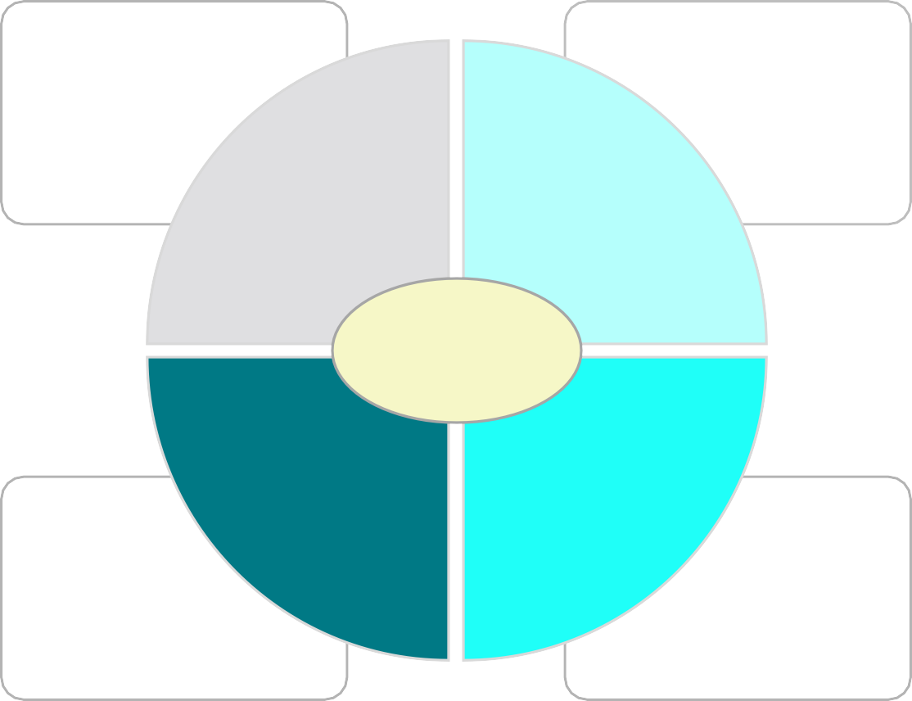
Health Care Workforce
Clinical Delivery System and Infrastructure
Educational Programs, Pipeline Programs, and Recruitment
Pool
Strategic Considerations
Expand Train
Innovate
Retain Recruit
To adequately address the clinical workforce shortage, New Mexico’s future strategies will need to focus on expanding health educational programs in parallel with growing healthcare infrastructure and attracting and retaining talent.
Compensation, Community Factors, Work-life Balance, Practice Environment
Scope of Practice, Loan Repayment, State Residency, and Practice Environment
New Mexico has a history of workforce innovation: Medical Education, Project Echo, Community Health Workers, and Scope of Practice.
17

Slide 18

Top Reasons Physicians Leave NM
SOM FY24 (n=80)
Personal/Family matter
Salary
Department Leadership
Work/Life balance
Work environment
LFC FY26 (n=600)
Punitive Damages
Med Mal Insurance
Quality of Life
Compensation
Administrative Burdens
UNM faculty retention 32% above national average.
18

Slide 19


Other UNM Workforce Initiatives
Pathway Programs
BELONG (Building Environments for Learning, Opportunity, Navigation and Growth) Taskforce ​
  Conducts short-, mid-, and long-term planning to enhance enrollment capacity and maintain quality within health professions programs.
Rural Residencies & Rotations
Will coordinate and incentivize increased rural residency and rotation placements throughout the state.
Behavioral Health Workforce
Behavioral Health Technical Assistance Center (BHTAC)
  Facilitates alignment and implementation of local and statewide behavioral health priorities among regional entities.
Master of Social Work Proposal
  May 19, 2026: SBOF approval received
  Summer 2026: Student recruitment begins
Operational Planning
SOM and CON 10-Year Business Plans
Space Utilization
Faculty Planning & Support

Slide 20
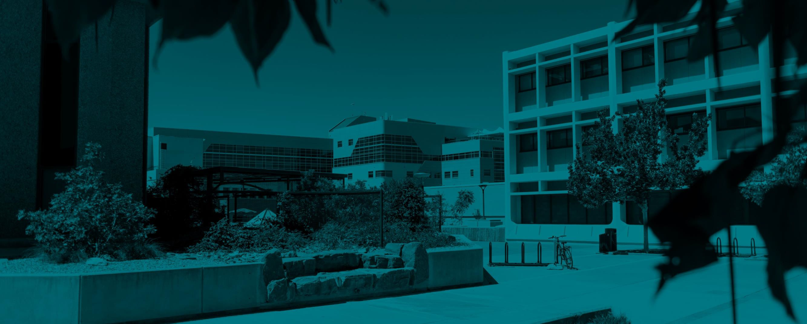

THANK YOU
20

